Slide 1

SecoT – A Complete Penetration Testing Suite for IoT Devices
Students
M.A. MOHAMMED ASEEM (210181601034)
T. MOHAMMED WASEEM AHMED (210181601038)
Project Supervisor
Dr. C. Hema (Associate Professor /CSE)
Domain
Cyber Security
SecoT – A Complete Penetration Testing Suite for IoT Devices
1st Review

Slide 2
Description of the Title
SecoT (Security of Things) is a penetration testing tool designed for IoT devices, focusing on firmware analysis and vulnerability detection. It extracts and inspects firmware, scans for CVEs, and allows manual testing.
SecoT – A Complete Penetration Testing Suite for IoT Devices
1st Review

Slide 3
Abstract
Existing solutions for IoT penetration testing often lack comprehensive firmware analysis and fail to address weak cryptographic practices or vulnerabilities in embedded libraries.
SecoT is an IoT penetration testing tool that extracts and analyzes firmware to identify security vulnerabilities.
It scans embedded files for CVEs, weak cryptographic practices, and vulnerabilities in libraries and dependencies. The tool performs host discovery, service scanning, and vulnerability detection, including checks for web application security in HTTP/HTTPS services.
SecoT offers manual testing capabilities for extracted files and a hash decryption interface for testing weak cryptographic practices.
SecoT – A Complete Penetration Testing Suite for IoT Devices
1st Review

Slide 4
Scope of the Project
The proposed system will focus on assessing:
Network vulnerabilities through scanning and service enumeration.
Firmware weaknesses by extracting and analysing code for hardcoded secrets and insecure configurations.
Debugging interfaces (UART, JTAG, SWD) for unauthorized access.
Communication protocols (e.g., MQTT, HTTP, BLE) for misconfigurations or security flaws.
SecoT – A Complete Penetration Testing Suite for IoT Devices
1st Review

Slide 5
Existing System
Current VAPT tools like Nmap, Wireshark, and Metasploit focus primarily on traditional IT systems and do not cater to the unique needs of IoT and edge devices.
Lack of Specialization: General-purpose tools aren’t designed for microcontroller-based devices or the specific protocols (e.g., MQTT, CoAP, BLE) used by IoT systems.
Manual and Disconnected Testing: Firmware analysis, hardware testing, and network scanning often require different tools, leading to fragmented workflows.
Limited Protocol Support: Standard tools have minimal support for IoT-specific communication protocols, requiring custom configurations or scripts.
SecoT – A Complete Penetration Testing Suite for IoT Devices
1st Review

Slide 6
Problem Statement
Current Vulnerability Assessment and Penetration Testing (VAPT) tools are not optimized for these devices, making it difficult to assess and secure them effectively.
Lack of penetration testing tools with multi-protocol support.
Lack of industry standard tool for IoT penetration testing.
SecoT – A Complete Penetration Testing Suite for IoT Devices
1st Review

Slide 7
Proposed System
Extract Firmware from Device: Extracts the firmware from an IoT device for further analysis.
Extract Embedded Files from Firmware: Unpacks the firmware to extract embedded files such as scripts, configurations, and binaries.
Scan Libraries/Dependencies for CVEs: Scans the extracted libraries and dependencies for known vulnerabilities (CVEs).
Manual Testing of Extracted Files: Allows pentesters to manually inspect the extracted files for vulnerabilities or misconfigurations.
SecoT – A Complete Penetration Testing Suite for IoT Devices
1st Review

Slide 8
Proposed System
Hash Decryption to Test Weak Cryptographic Practices: Provides a decryption interface to check for weak cryptographic practices in the firmware files.
Host Discovery: Identifies active devices on a network by scanning for online hosts and their IP addresses.
Service Scanning: Detects open ports and services running on identified hosts to assess their vulnerabilities.
Ecosystem Web App Vulnerability Scanning: Scans web applications or APIs in the IoT ecosystem for common security vulnerabilities like SQL injection and XSS.
SecoT – A Complete Penetration Testing Suite for IoT Devices
1st Review

Slide 9
Input-Process-Output (IPO)
Input
<FILL THIS>
Firmware file: Firmware extracted from the embedded device or received from the manufacturer
Firmware Simulation: A virtual environment that mimics the behavior of the IoT device’s ecosystem, allowing for network and service scanning without direct access to the physical device.
SecoT – A Complete Penetration Testing Suite for IoT Devices
1st Review

Slide 10
Input-Process-Output (IPO)
Process
<Fill this>
Firmware Analysis: Unpack and analyze the firmware and its embedded files for vulnerabilities.
Libraries and Dependencies Vulnerability Scanning: Use vulnerability databases to scan libraries and dependencies in the firmware for known CVEs.
Manual Testing: Allow manual inspection of extracted files for additional vulnerabilities.
Hash Decryption: Check the cryptographic strength of hashes used in the firmware to detect weak encryption.
Host Discovery: Perform network scans to identify active devices on the network.
Vulnerable Service Scanning: Scan open ports and services on identified hosts for potential vulnerabilities.
Web Application Vulnerability Scanning: Scan web-based applications or APIs within the IoT ecosystem for common web security issues like XSS and SQL Injection.
SecoT – A Complete Penetration Testing Suite for IoT Devices
1st Review

Slide 11
Input-Process-Output (IPO)
Output
Firmware Extraction: <Fill This>
Extracted Files: The percentage of extraction of files embedded in the Firmware
Vulnerability Detection: The percentage of known vulnerabilities (CVEs) successfully detected in libraries and services.
Host and Service Coverage: The percentage of active hosts and services identified and tested.
Web Application Vulnerability Coverage: The completeness of vulnerability scanning for web-based components of the IoT ecosystem.
SecoT – A Complete Penetration Testing Suite for IoT Devices
1st Review

Slide 12
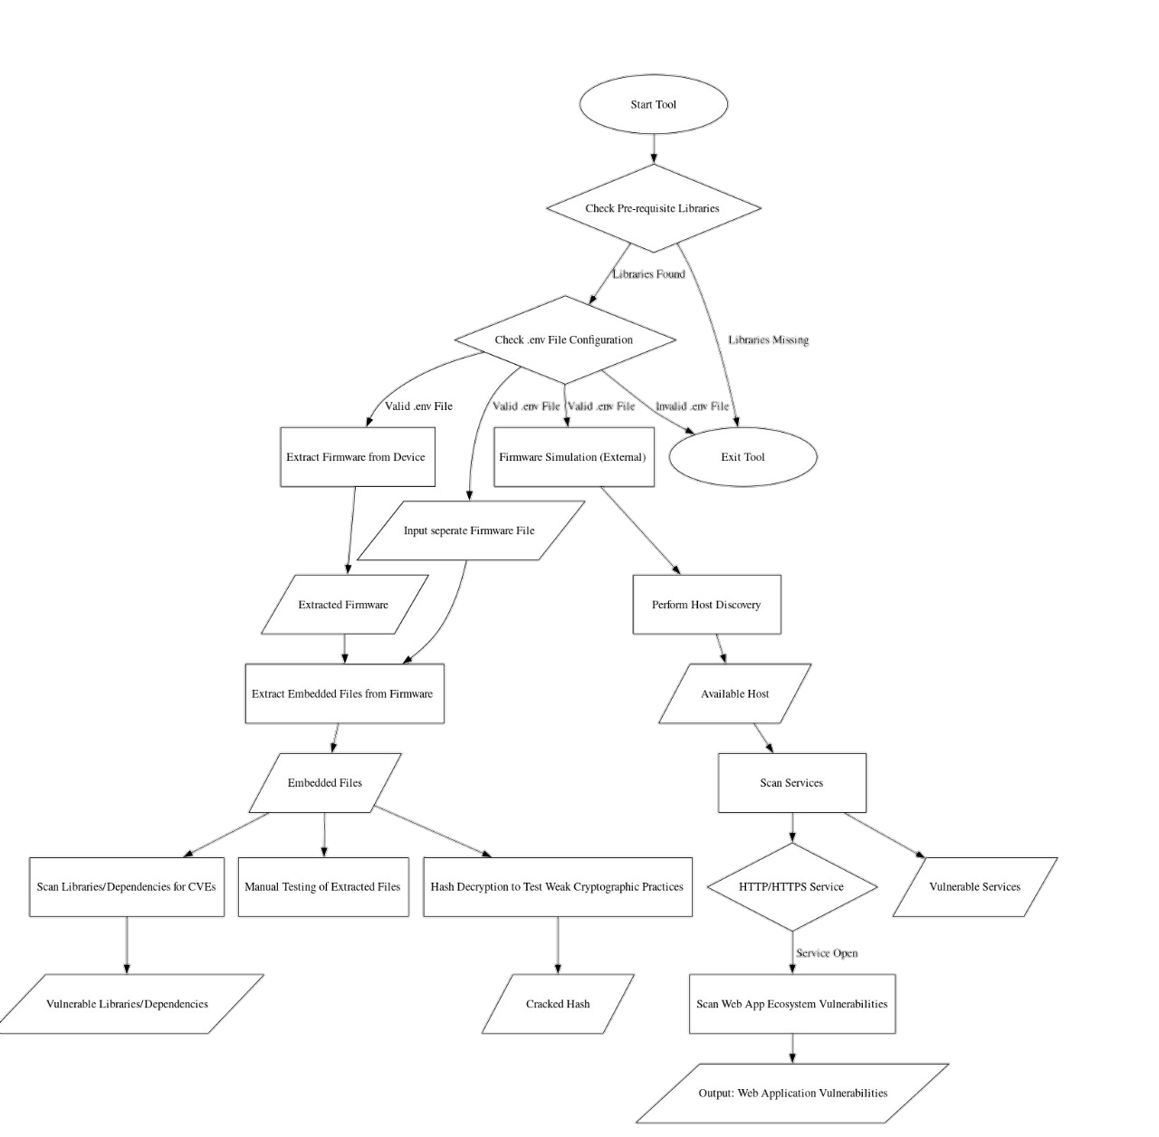
Architecture Diagram
SecoT – A Complete Penetration Testing Suite for IoT Devices
1st Review

Slide 13
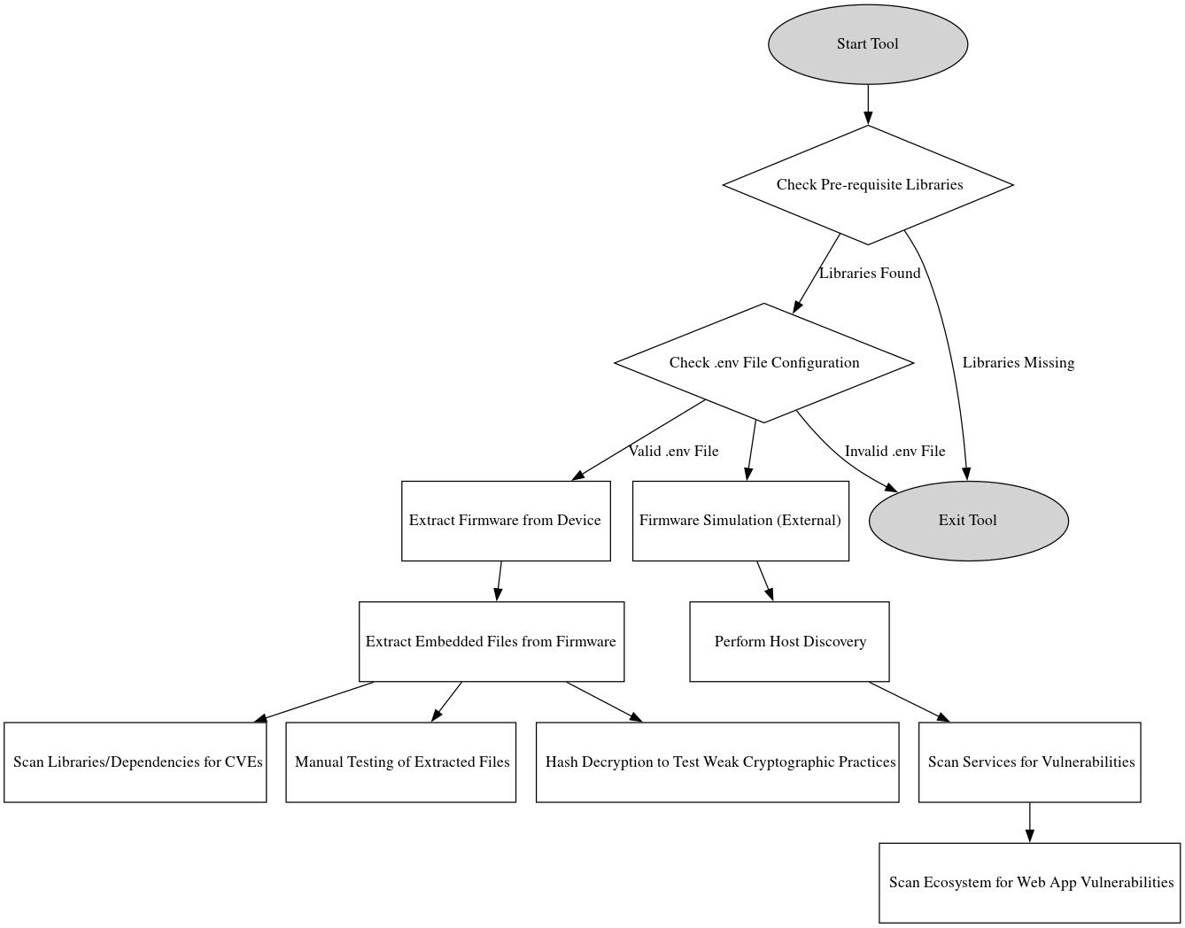
Architecture Diagram
SecoT – A Complete Penetration Testing Suite for IoT Devices
1st Review

Slide 14
Modules
Startup Process: Verifies the installation of required libraries and configuration of the .env file before starting the tool.
Firmware Extraction: Extracts firmware from an IoT device for further analysis.
Embedded File Extraction: Unpacks the firmware to retrieve embedded files like binaries, scripts, and configurations.
Host Discovery: Identifies active devices on a network by scanning for online hosts and their IP addresses.
Service Scanning: Detects open ports and services running on discovered hosts to assess their security.
SecoT – A Complete Penetration Testing Suite for IoT Devices
1st Review

Slide 15
Modules
CVE Scan: Scans libraries and dependencies in the firmware for known vulnerabilities (CVEs).
Manual Testing: Allows pentesters to manually inspect extracted firmware files for vulnerabilities or misconfigurations.
Hash Decryption: Provides an interface to test and decrypt weak cryptographic practices found in the firmware files.
SecoT – A Complete Penetration Testing Suite for IoT Devices
1st Review

Slide 16
Software
<TO BE FILLED> [DOUBT]
SecoT – A Complete Penetration Testing Suite for IoT Devices
1st Review

Slide 17
Front End Design
<Fill This>
SecoT – A Complete Penetration Testing Suite for IoT Devices
1st Review

Slide 18
Reference Papers
Bella, G., Biondi, P., Bognanni, S. and Esposito, S., 2023. PETIoT: PEnetration testing the internet of things.Internet of Things,22, p.100707.
Sasi, T., Lashkari, A.H., Lu, R., Xiong, P. and Iqbal, S., 2023. A comprehensive survey on IoT attacks: Taxonomy, detection mechanisms and challenges.Journal of
Information and Intelligence.
Khan, N.A., Awang, A. and Karim, S.A.A., 2022. Security in Internet of Things: A review.IEEE access,10, pp.104649-104670.
Azrour, M., Mabrouki, J., Guezzaz, A. and Kanwal, A., 2021. Internet of things security:
challenges and key issues.Security and Communication Networks,2021(1), p.5533843.
Akhilesh, R., Bills, O., Chilamkurti, N. and Chowdhury, M.J.M., 2022. Automated penetration testing framework for smart-home-based IoT devices.Future Internet,14(10), p.276.
Sivasankari, N. and Kamalakkannan, S., 2022. Detection and prevention of man-in- the-middle attack in iot network using regression modeling.Advances in Engineering software,169, p.103126.
SecoT – A Complete Penetration Testing Suite for IoT Devices
1st Review

Slide 19
Reference Papers
Chatterjee, A. and Ahmed, B.S., 2022. IoT anomaly detection methods and applications: A survey.Internet of Things,19, p.100568.
Baho, S.A. and Abawajy, J., 2023. Analysis of consumer IoT device vulnerability quantification frameworks.Electronics,12(5), p.1176.
Rana, M., Mamun, Q. and Islam, R., 2022. Lightweight cryptography in IoT networks: A survey.Future Generation Computer Systems,129, pp.77-891.
Rachit, Bhatt, S. and Ragiri, P.R., 2021. Security trends in Internet of Things: A survey.SN Applied Sciences,3, pp.1-14.
Srivastava, A., Gupta, S., Quamara, M., Chaudhary, P. and Aski, V.J., 2020. Future IoT‐ enabled threats and vulnerabilities: State of the art, challenges, and future prospects.International Journal of Communication Systems,33(12), p.e4443.
Farooq, U., Tariq, N., Asim, M., Baker, T. and Al-Shamma'a, A., 2022. Machine learning and the Internet of Things security: Solutions and open challenges.Journal of Parallel and Distributed Computing,162, pp.89-104.
Feng, X., Zhu, X., Han, Q.L., Zhou, W., Wen, S. and Xiang, Y., 2022. Detecting vulnerability on IoT device firmware: A survey.IEEE/CAA Journal of Automatica Sinica,10(1), pp.25-41.
SecoT – A Complete Penetration Testing Suite for IoT Devices
1st Review

Slide 20
Reference Papers
Jaafar, A.G., Ismail, S.A., Habir, A., Zainol Ariffin, K.A. and Yusop, O.M., 2024. A Raise of Security Concern in IoT Devices: Measuring IoT Security Through Penetration Testing Framework.International Journal of Advanced Computer Science & Applications,15(5).
Sahu, S.K. and Mazumdar, K., 2024. Exploring security threats and solutions Techniques for Internet of Things (IoT): from vulnerabilities to vigilance.Frontiers in Artificial Intelligence,7, p.1397480.
SecoT – A Complete Penetration Testing Suite for IoT Devices
1st Review

